Slide 1
Data Science and Openshift on the MOC
Michael Clifford | Anand Sanmukhani
Red Hat Inc.
Yousif | Zhuofa | Krishna | Fangya | Nihar | Ojasvi
EC/CS 528 Cloud Computing Course
Notes:
Nihar

Slide 2
Quick recap - Project Description
Goals:
Improve the Prometheus Anomaly Detection (PAD) System by extending it with a new model(s)
Making PAD available on Open DataHub on MOC
Understand the current PAD data-pipeline
Notes:
Nihar

Slide 3
Current Sprint Progress
Communicating with prometheus
Familiarization with Prometheus API Client
Querying prometheus for a specific metric
Implemented ML models on a single Numenta Anomaly Benchmark (NAB) dataset
ARIMA
Prophet
Started Deploying PAD onto MOC (under progress)
Created a slack channel for communication with our mentors
Notes:
Nihar

Slide 4
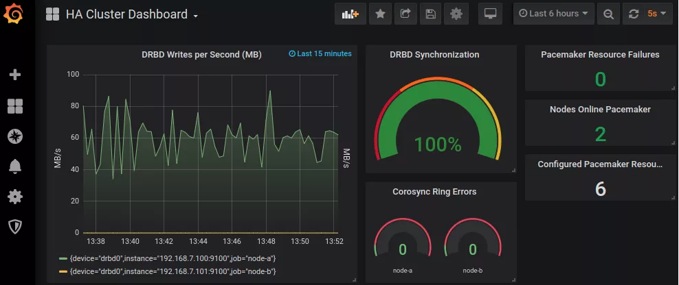
Prometheus
Monitoring system & time series database
Prometheus is a free software application used for event monitoring and alerting.
It records real-time metrics in a time series database built using a HTTP pull model, with flexible queries and real-time alerting.
Notes:
Marco
Here let me do a recap for the prometheus.
Prometheus is a free software application used for monitoring the operation of the system and providing alerting. It records real-time metrics in a time series (usually 1 day or 2) database and has flexible queries and real-time alerting. It implements high dimensional data models, equips the user with promQL, visualization tools, high storage and easy integration with extensive library support.
This figure shows an example of using prometheus. On the left, we monitor the input data, on the right, it provides some alert. my friend yousif will take over the following and discuss how to communicate with prometheus,

Slide 5
Communicating with Prometheus
Use promQL to choose and monitor a specific metric
Specify the start and end time of which you want to monitor
Utilize Prometheus API to get the data of that metric
Notes:
Yousif

Slide 6
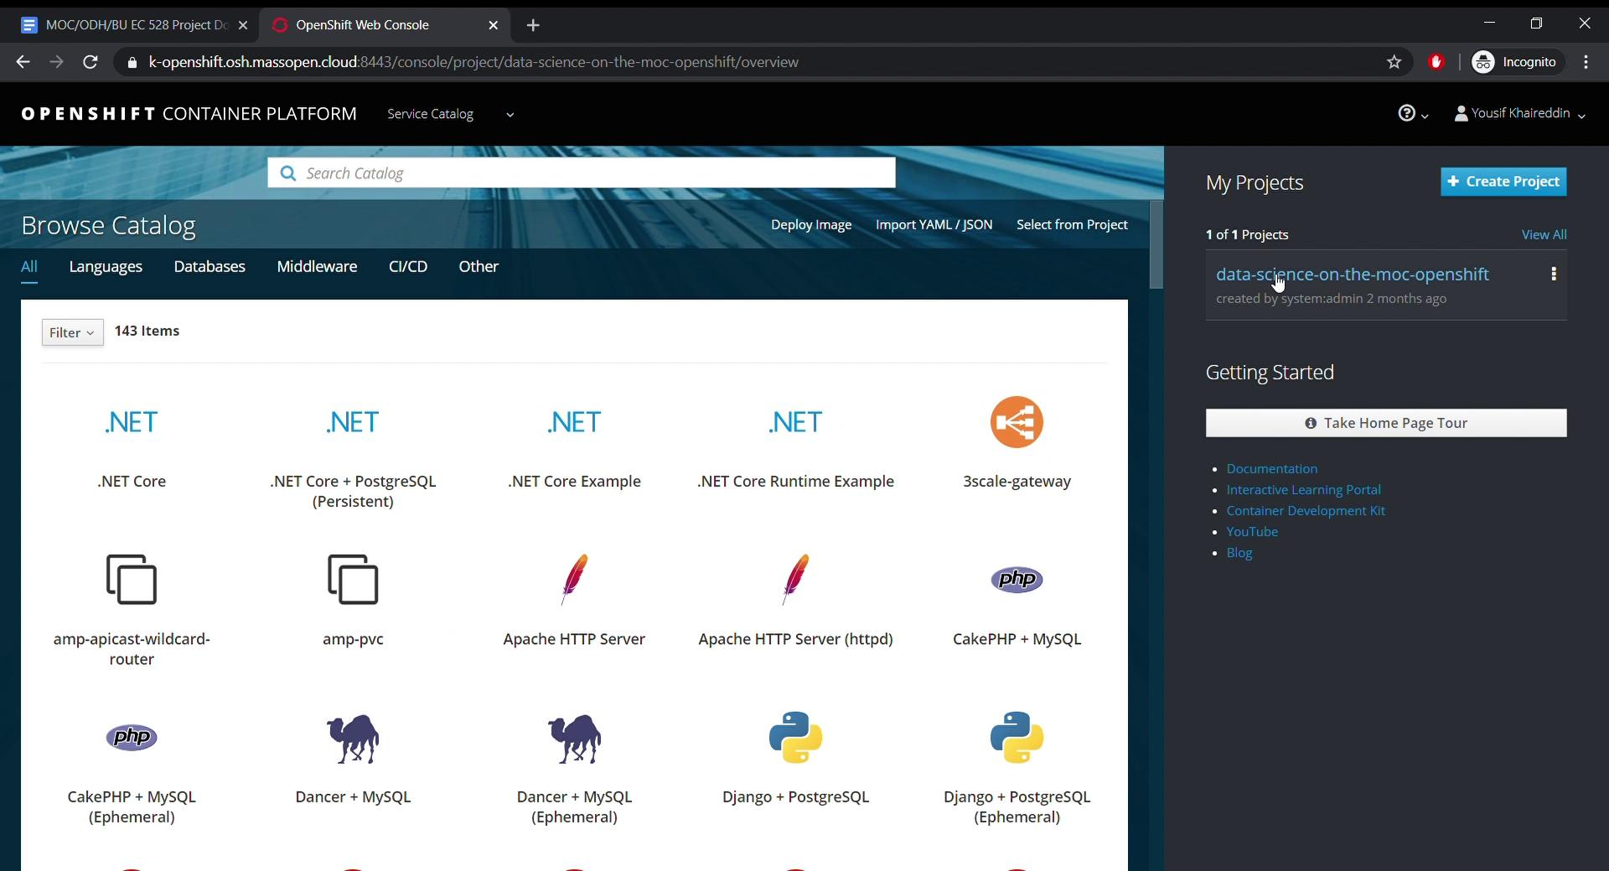
Notes:
Yousif

Slide 7
Numenta Anomaly Benchmark (NAB)
https://github.com/numenta/NAB
a novel benchmark for evaluating algorithms for anomaly detection in streaming, real-time applications.
over 50 labeled real-world and artificial time-series data
Some of the datasets of NAB are:
realAWSCloudwatch/ (AWS cloud data)
realAdExchange/ (Online advertisement clicking rates)
realTraffic/ ( Twin Cities Metro area in Minnesota)
realTweets/
artificialNoAnomaly/ and artificialNoAnomaly/
Notes:
Krishna

Slide 8
ML Models
ARIMA
Auto Regressive - p [number of weighted error terms]
Integrated - d [degree of differencing to reduce seasonality]
Moving Average - q [previous observations to consider]
Prophet (from Facebook)
additive model, m(x) = g(x) + s(x) + h(x) + e
g(x) - models trend
s(x) - models seasonality
h(x) - models special events
e - irreducible error
Notes:
Krishna

Slide 9
Colab Notebook Walkthrough
Notes:
Krishna

Slide 10
Deploying PAD on MOC
A deployment in OpenShift Enterprise is a replication controller based on a user defined template called a deployment configuration. Deployments are created manually or in response to triggered events.
We deploy PAD using a YAML config file we got from its github repo.

Slide 11
What we learned?
Using JupyterHub on MOC
Prometheus Data pipeline and its API client interface
Understanding the dynamics of time series data using NAB dataset
Working and implementation of Time series forecasting models (ARIMA, Prophet)
Notes:
Ojasvi
We were successfully able to run JupyterHub on OpenDataHub deployed on MOC.
We were able to understand the Prometheus’s Data Pipeline and the API interface it provides (Which was a problem we were facing in the previous sprint)

Slide 12
What we couldn’t learn or had problems with?
Querying prometheus always gives 1 day of data, no matter what!
Metric selection and the possibility of applying an RNN model
Deploying PAD on MOC is hard (to say the least!)
Coronavirus!
Notes:
Ojasvi
Prometheus is our Metric Database as explained before. This gives us the input data to train our model/network and predict the values for a particular metric. Right Now, when we query it, it gives us the data for only one day.
RNN / LSTM models are good at processing language. For e.g. translation, prediction etc. Remember the example we did in the class. Predicting numbers/Metric values is not a usecase for RNN. We ran this idea of implementing a RNN for anomaly detection by our mentors. They’re Excited but unsure.
Deployment of PAD has been documented poorly.
This Pandemic is certainly a problem. We’re scared to get out and meet in person. Our weekly meetings are tricky to say the least. And personally I am left with no Peace in my mind and no skin on my hand from all the hand washing.

Slide 13
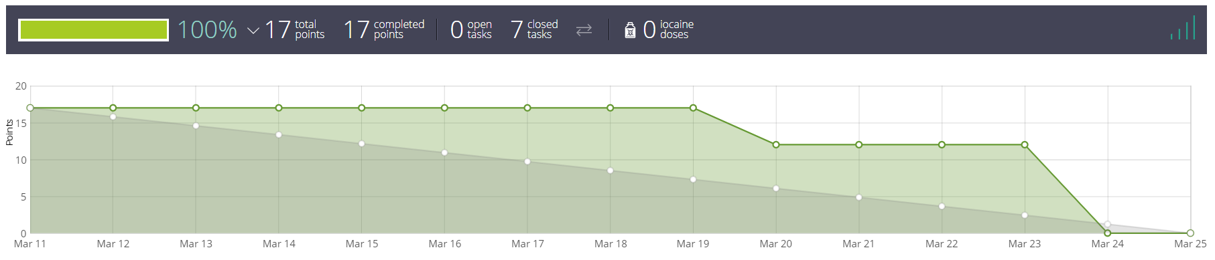
Burndown Chart
Notes:
Fangya

Slide 14
Next Sprint
Moving all current ML deployments to JupyterHub
ML Model Implementation
Applying ARIMA, Prophet models to other real-time time-series data from NAB dataset
Implementing LSTM models and observing if that is a good idea (https://github.com/numenta/NAB/tree/master/data)
Deploying PAD on MOC
JupyterHub Testing
Running memory heavy jobs on JupyterHub to test its bounds
Metric Selection
Understand the metrics that Prometheus is tracking for the JupyterHub application and picking metrics to work on.
Notes:
Fangya

Slide 15
Questions?

Slide 16
Previous Sprint Progress (2nd Sprint)
PAD Familiarization
We reviewed the notebooks containing the data pipelines and models of the current implementation of PAD
Literature Review
Literature review of time series forecasting models focussing on LSTM architectures
Deployments
We deployed Open Data Hub on our local machine (Our mentors deployed it onto the MOC on our behalf)
JupyterHub
We have familiarized ourselves with running JupyterHub on MOC
Notes:
Nihar

